Slide 1
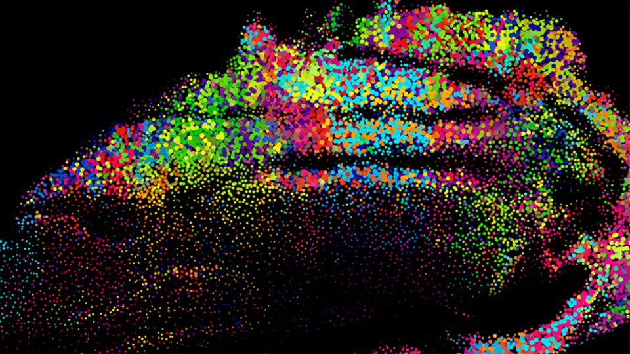

Neural Networks from Scratch Final Project - #3 Mystery Dataset
Edmund Tsou
Johns Hopkins University
B.S. Biomedical Engineering & Computer Science

Slide 2
Goal: Create the best MLP to classify mystery dataset

Slide 3
Dataset Exploration
Dataset details:
CSV tabular data
train: 8000 examples x 205 features
  Each example had a class label (0, 1, 2, 3, 4) with 5 possible classes
test: 2000 examples x 205 features with no labels

Slide 4
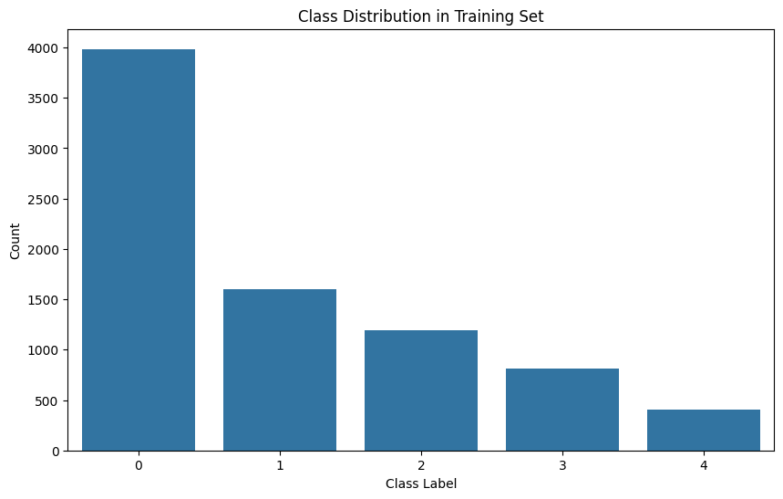
Dataset Exploration: class imbalance
Observation 1: clear class imbalances -> will be theme later

Slide 5
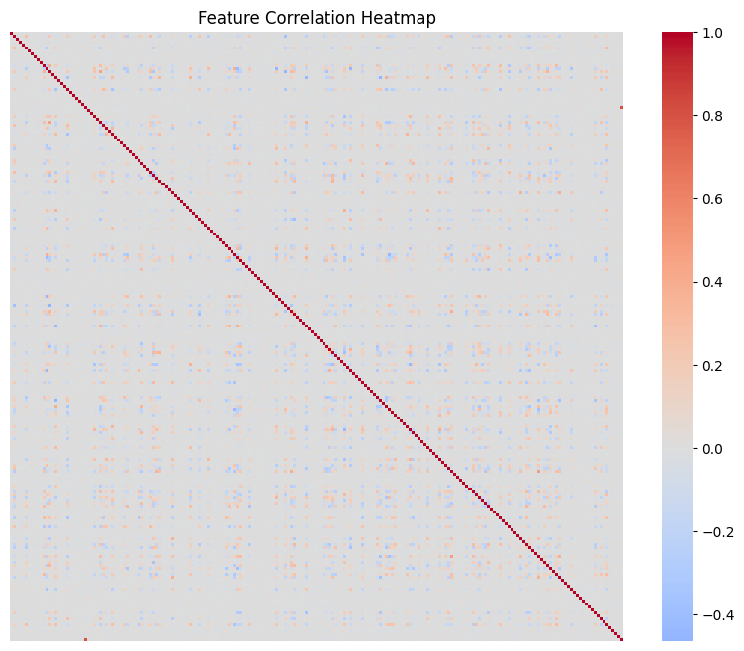
Dataset Exploration: feature correlations
Observation 2: features are roughly uncorrelated
Uses Pearsons correlation
No multicollinearity to worry about

Slide 6
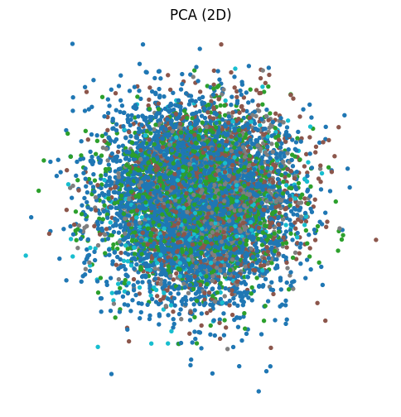
Dataset Exploration: PCA
First 50 components
Explained variance (50 PCs): 47.6%
  Makes sense considering features are mostly uncorrelated

Slide 7
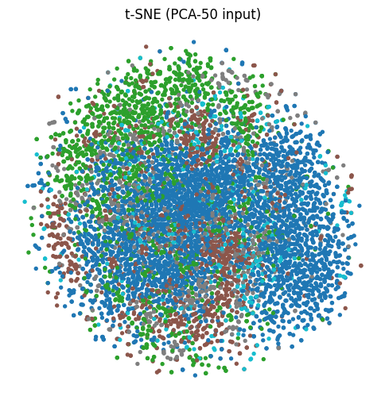
Dataset Exploration: T-SNE
First 50 components
Preserves local neighborhoods

Slide 8
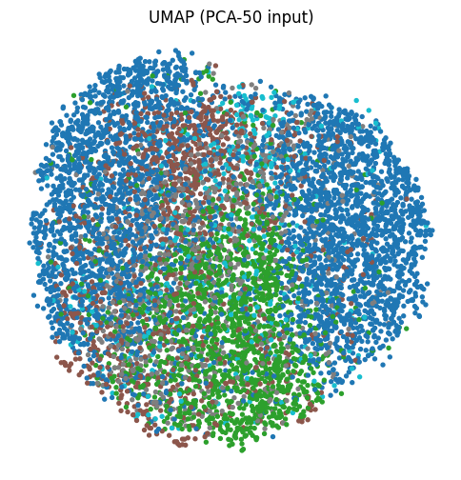
Dataset Exploration: UMAP
First 50 components
Preserves local neighborhoods and some global structure
Takeaway: class differences are subtly and may rely on non-obvious patterns

Slide 9
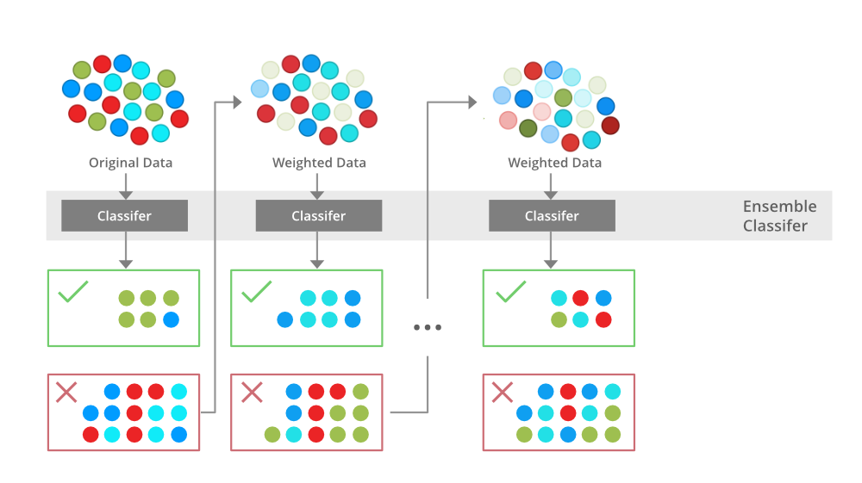
Baseline Model: XGBoost
XGBoost is often best performing model on tabular data
Use XGBoost as baseline and see if we can beat it with MLP

Slide 10
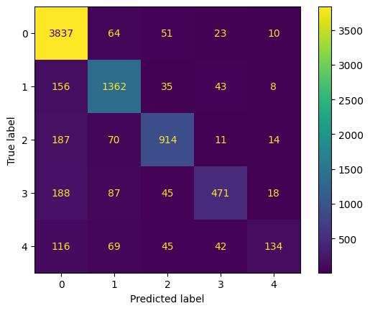
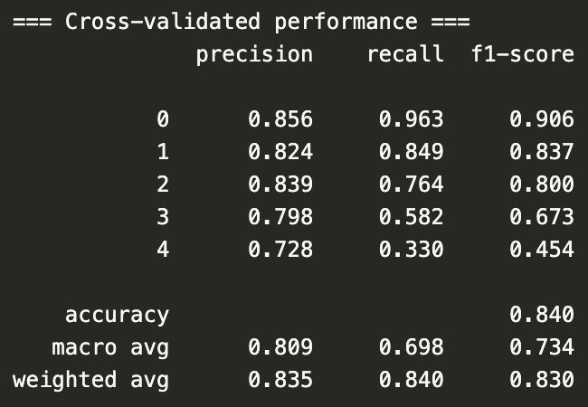
Baseline Model: XGBoost
Methods:
Use 5-fold cross validation with shuffling
For each training fold, calculate inverse weights based on the frequency of the class
Train XGboost model with 660 estimators (found from hyperparameter grid search)
Results:
Accuracy: 0.84
Performed much worse on smaller classes

Slide 11
MLP Model 1: standard MLP
Methods:
Standardize features**
Architecture and hyperparameters
  2 hidden layers (512, 256)
  Dropout (0.35)
  Weight Decay (1e-4): basically L2 regularization
  AdamW optimizer (lr=1e-3)
  Batch Normalization
  Cross-Entropy Loss
Inverse class weights
Trained for 40 epochs
5-fold cross validation
Regularization to prevent overfitting
** forgot this at first but makes a big different, accuracy shot up 3-4% after standardizing

Slide 12
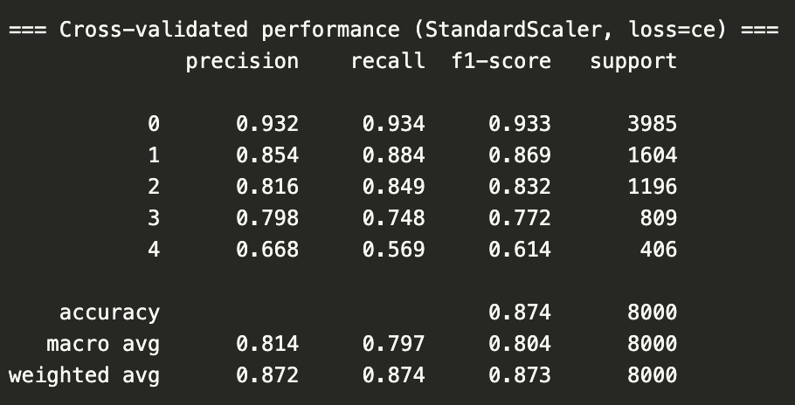
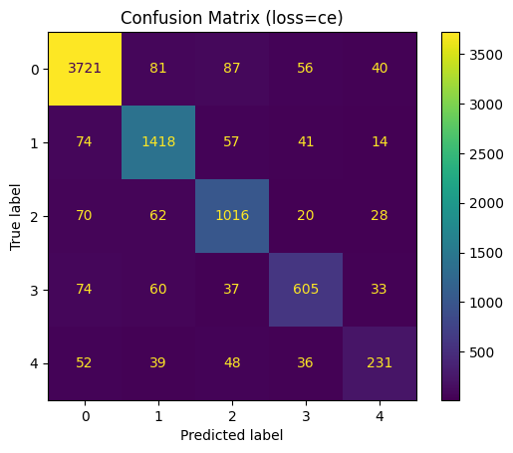
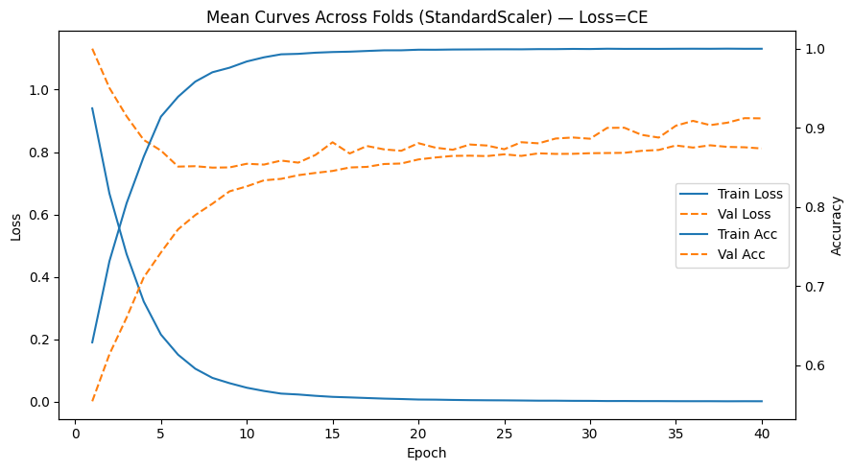
MLP Model 1: standard MLP
Overall accuracy: 0.874
  Better than XGboost!
Problem 1: does better on smallest dataset but still not great
Problem 2: Clear signs of overfitting as accuracy holds constant but loss increases over training epochs

Slide 13
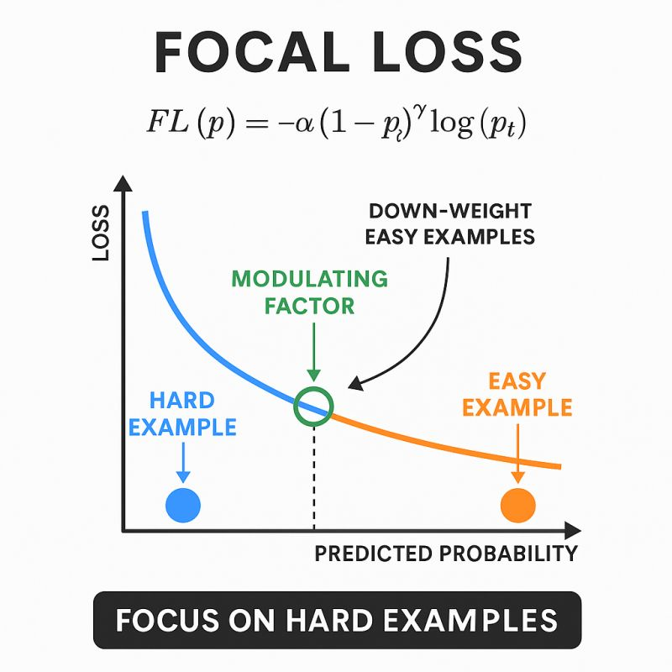
MLP Model 2: standard MLP with focal loss
Methods:
Same exact model as model 1 but using focal loss
Focuses on “hard” example (i.e smaller classes) and less on “easy” examples
Modified cross-entropy loss
Gamma is focusing parameter
  When gamma = 0, same as CE
  When gamma higher, higher probability or confidence outputs are weighted less to loss function

Slide 14
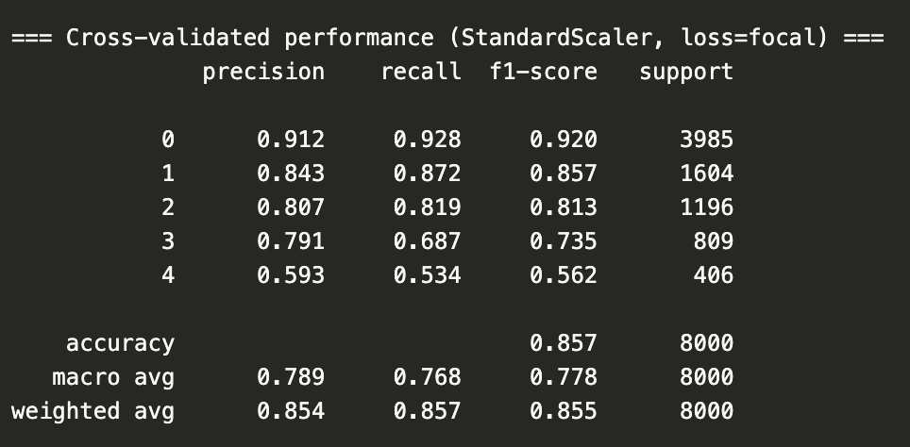

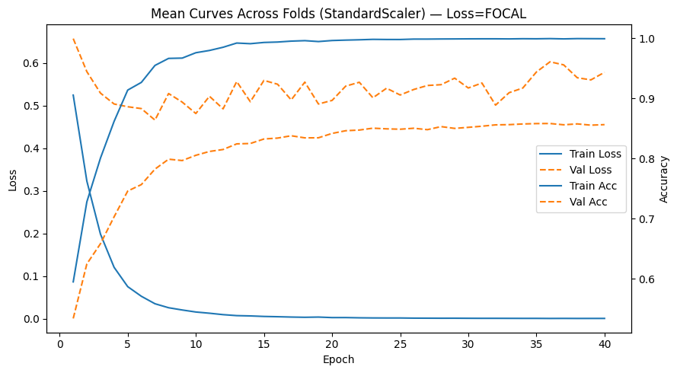
MLP Model 2: standard MLP with focal loss
Overall accuracy: 0.857
Performance got worse
  Hypothesis: focal loss is notoriously sensitive to outliers
Problem: still overfitting

Slide 15
MLP Model 4: wide and deep NN
Methods:
Standardize features
Architecture and hyperparameters
  Deep: 3 hidden layers funneled (256, 128, 64) (generalize)
  Wide: input features fed directly to final logits (memorize)
  Dropout (0.35) + Weight Decay (1e-4)
  AdamW optimizer (lr=1e-3)
  Switch to LeakyReLU (alpha=0.1)
  Batch normalization
  Cross-Entropy Loss
Inverse class weights
Trained for 40 epochs
5-fold cross validation

Slide 16
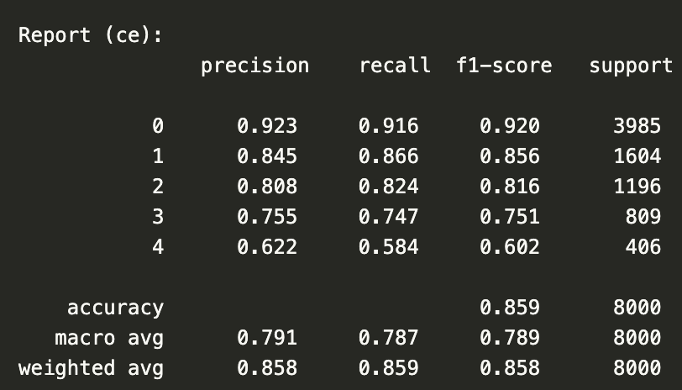

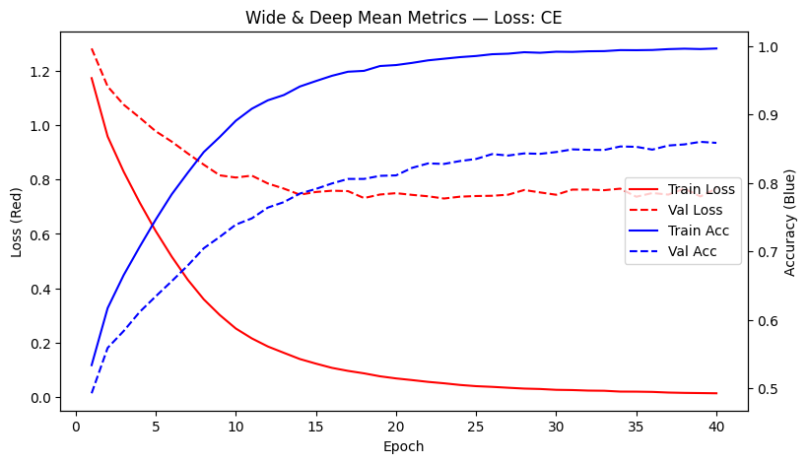
MLP Model 4: wide and deep NN
Overall accuracy: 0.859
Performance got worse
  Hypothesis: focal loss is notoriously sensitive to outliers
Seemed to help overfitting, more stable training loss and accuracy curves

Slide 17
MLP Model 5: two-stage classifer
Methods:
Standardize features
Binary detector: just distinguish class 4 from rest of classes to help class imbalance
Multiclass detector: distinguish classes 0-3
Same architecture as model 1
4) Train both for 40 epochs
5) 5-fold cross-validation

Slide 18
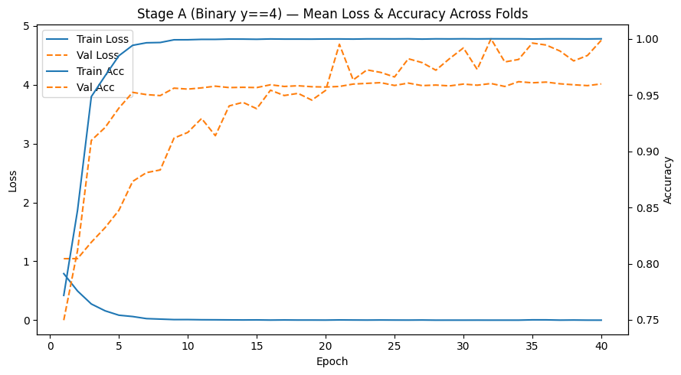
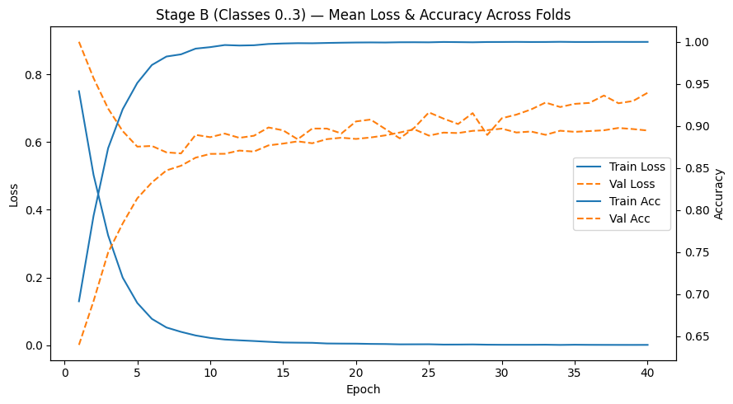
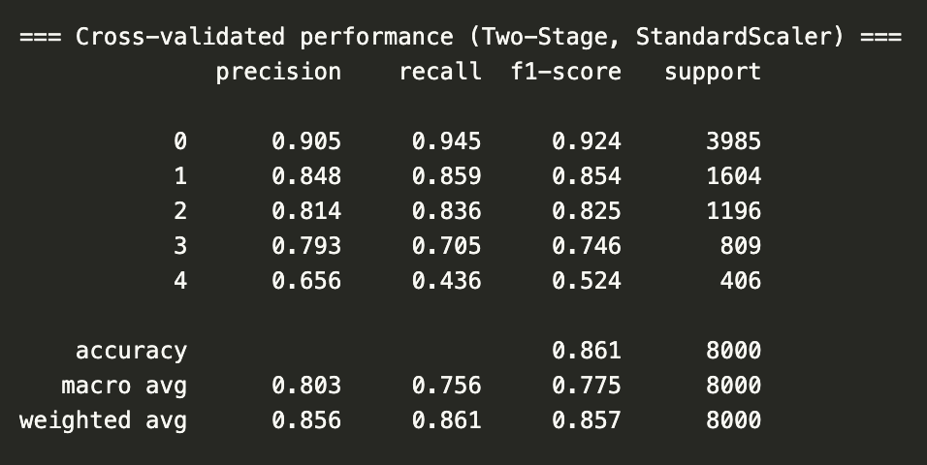
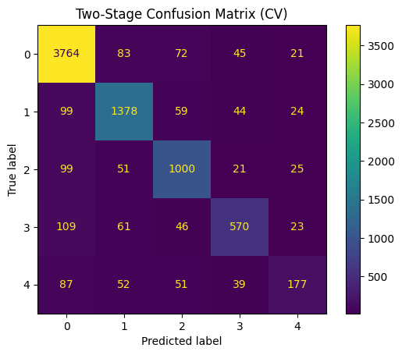
MLP Model 5: two-stage classifer
TLDR: accuracy 0.861, didn’t help much
Hypothesis: errors from first classifier propagate; loss of shared feature representation and interclass contrast

Slide 19
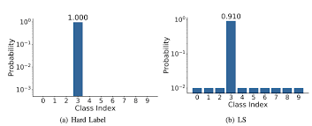
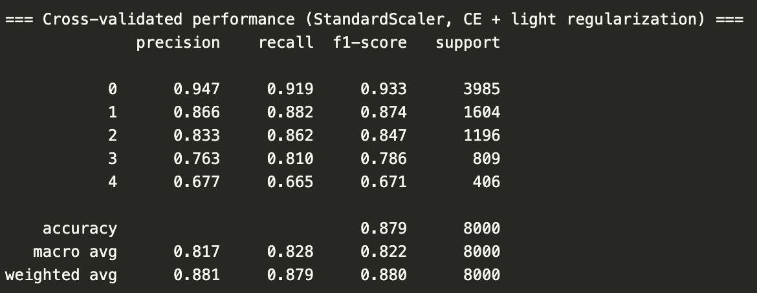
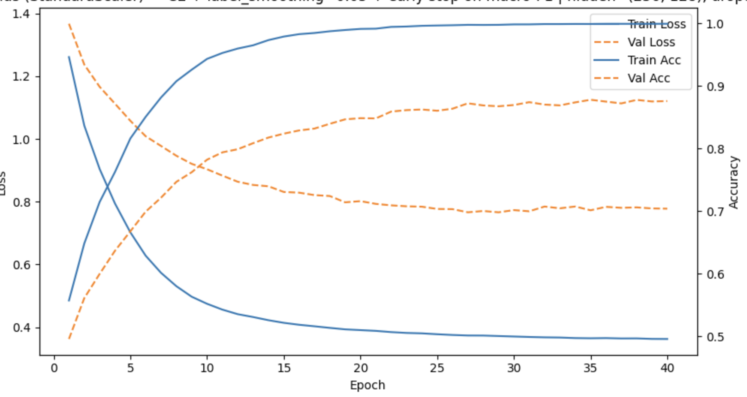
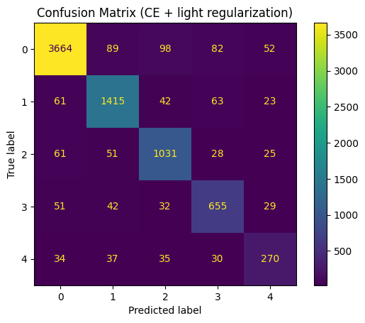
MLP Model 6: standard MLP + more regularization
Model 1 + early stopping and label smoothing + more weight decay
TLDR: accuracy = 0.879
Helped smooth loss and accuracy curves showing best performance

Slide 20
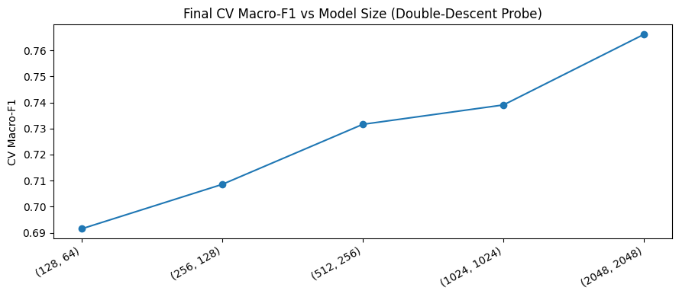
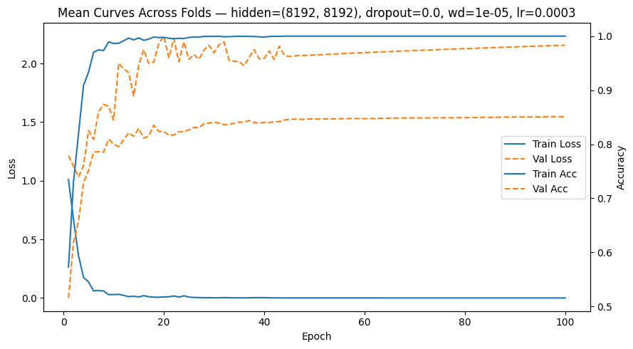
MLP Model 7: double descent
Tried heavily overparameterizing the model to get double descent, trained up to (8192, 8192), yielded continuously increasing accuracies up to 0.86 but couldn’t train anything larger with laptop compute

Slide 21
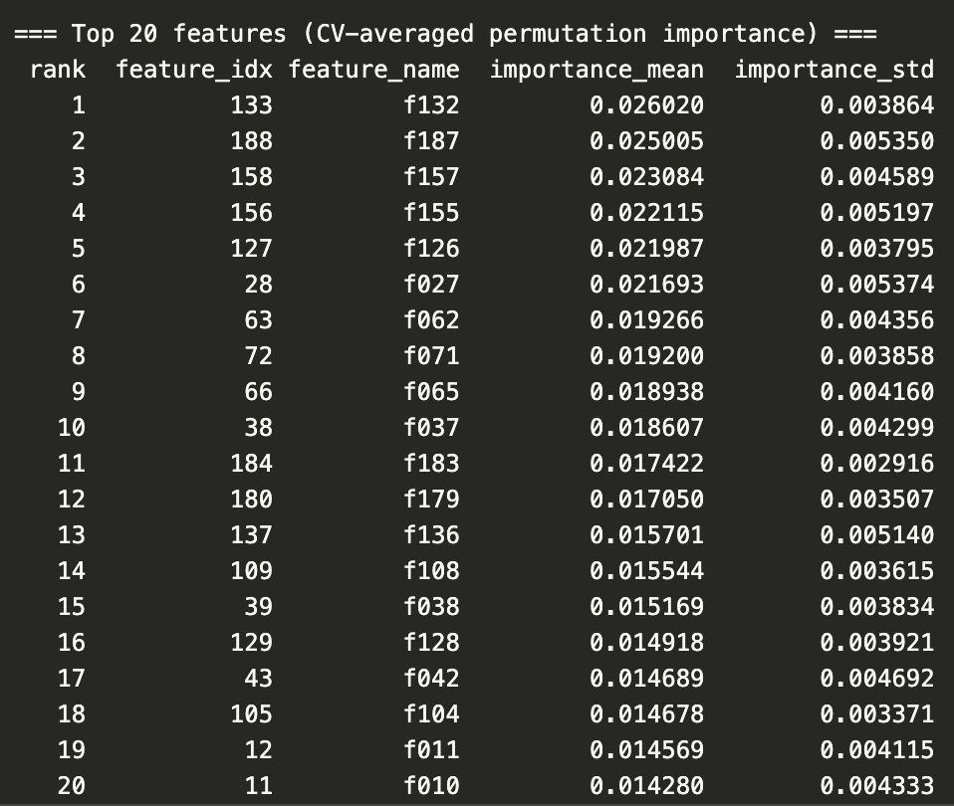
Feature importance: from model 1 MLP
If we randomly shuffle a features values, how much does accuracy drop?

Slide 22
Takeaways
Experimented with a lot of MLP architectures and parameters, but couldn’t pass the high 80s for accuracy
Likely class imbalance holding the model back and this is near the limit of what MLPs can do
More advanced techniques can often overcomplicate things and lead to worse results
Hard to beat simple MLP model with regularization

Slide 23
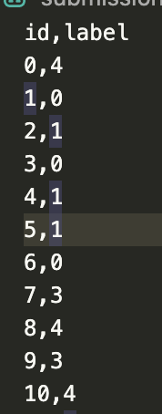
Final Scores
Trained best light regularization Model 6 on full train.csv and predicted test.csv for 40 epochs

